Slide 1
Lecture 2: Data and Dataset
Mr. Vaibhav Chunekar
Assistant Professor
KJSCE
Date: 28/7/2023

Slide 2
Data Objects
Data sets are made up of data objects.
A data object represents an entity.
Examples:
sales database: customers, store items, sales
medical database: patients, treatments
university database: students, professors, courses
Also called samples , examples, instances, data points, objects, tuples.
Data objects are described by attributes.
Database rows -> data objects; columns ->attributes.

Slide 3
Attributes
Attribute (or dimensions, features, variables): a data field, representing a characteristic or feature of a data object.
E.g., customer _ID, name, address
Types:
Nominal
Binary
Ordinal
Numeric: quantitative
Interval-scaled
Ratio-scaled

Slide 4
Attribute Types
Nominal: categories, states, or “names of things”, do not have any meaningful order, enumeration
Hair_color = {auburn, black, blond, brown, grey, red, white}
marital status, occupation = Not =
Binary
Nominal attribute with only 2 states (0 and 1)
Symmetric binary: both outcomes equally important, have same weight
e.g., gender
Asymmetric binary: outcomes not equally important.
e.g., medical test (positive vs. negative)
Convention: assign 1 to most important outcome (e.g., HIV positive)
Ordinal
Values have a meaningful order (ranking) but magnitude between successive values is not known. < >
Size = {small, medium, large}, grades{A,B,C,D}, army rankings

Slide 5
Numeric Attribute Types
Quantity (integer or real-valued)
Interval
Measured on a scale of equal-sized units
Values have order + -
E.g., temperature in C˚or F˚, calendar dates
No true zero-point
Can compare and quantify
Numeric in nature
Measures of central tendency(mean, median, mode)
Ratio
Inherent zero-point
We can speak of values as being an order of magnitude larger than the unit of measurement (10 K˚ is twice as high as 5 K˚).
e.g., temperature in Kelvin, length, counts, monetary quantities

Slide 6
Discrete vs. Continuous Attributes
Attributes ML point of view
Discrete Attribute
Has only a finite or countably infinite(one to one correspondence with natural number)set of values
E.g., zip codes, profession, or the set of words in a collection of documents
Sometimes, represented as integer variables
Note: Binary attributes are a special case of discrete attributes
Continuous Attribute
Has real numbers as attribute values
E.g., temperature, height, or weight
Practically, real values can only be measured and represented using a finite number of digits
Continuous attributes are typically represented as floating-point variables

Slide 7
Asymmetric Attributes
Only presence (a non-zero attribute value) is regarded as important
Words present in documents
Items present in customer transactions
If we met a friend in the grocery store would we ever say the following? “I see our purchases are very similar since we didn’t buy most of the same things.”

Slide 8
Critiques of the attribute categorization
Incomplete
Asymmetric binary
Cyclical
Multivariate
Partially ordered
Partial membership
Relationships between the data
Real data is approximate and noisy
This can complicate recognition of the proper attribute type
Treating one attribute type as another may be approximately correct

Slide 9
Key Messages for Attribute Types
The types of operations you choose should be “meaningful” for the type of data you have
Distinctness, order, meaningful intervals, and meaningful ratios are only four (among many possible) properties of data
The data type you see – often numbers or strings – may not capture all the properties or may suggest properties that are not present
Analysis may depend on these other properties of the data
Many statistical analyses depend only on the distribution
In the end, what is meaningful can be specific to domain

Slide 10
Important Characteristics of Data
Dimensionality (number of attributes)
High dimensional data brings a number of challenges
Sparsity
Only presence counts.
Skew data
Non zero values are important
Resolution
Patterns depend on the scale
Size
Type of analysis may depend on size of data

Slide 11
Dimensionality of a data
The dimensionality of a data set is the number of attributes that the objects in the data set have.
In a particular data set if there are high number of attributes (also called high dimensionality), then it can become difficult to analyse such a data set. When this problem is faced, it is referred to as Curse of Dimensionality.
In order to understand what the hell is this Curse of Dimensionality, we first need to understand the other two characteristics of Data.

Slide 12
Sparsity
For some data sets, such as those with asymmetric features, most attributes of an object have values of 0; in many cases fewer than 1% of the entries are non-zero. Such a data is called sparse data or it can be said that the data set has Sparsity.

Slide 13
Resolution
The patterns in the data depend on the level of resolution. If the resolution is too fine, a pattern may not be visible or may be buried in noise; if the resolution is too coarse, the pattern may disappear. For example, variations in atmospheric pressure on a scale of hours reflect the movement of storms and other weather systems. On a scale of months, such phenomena are not detectable

Slide 14
Curse of Dimensionality
Many types of Data Analysis becomes difficult as the dimensionality (number of attributes in the data set) of the data set increases.
Specifically, as dimensionality increases, the data becomes increasingly sparse in the space that it occupies.
For classification, this can mean that there are not enough data objects to allow the creation of a model that reliably assigns a class to all possible objects.
For clustering, the definitions of density and the distance between points, which are critical for clustering, become less meaningful.

Slide 15
Data sets
A Data set is a set or collection of data.
This set is normally presented in a tabular pattern.
Every column describes a particular variable.
And each row corresponds to a given member of the data set, as per the given question.
This is a part of data management

Slide 16
Types of Data Sets in statistics
Numerical data sets
Bivariate data sets
Multivariate data sets
Categorical data sets
Correlation data sets

Slide 17
Numerical Data Sets
The numerical data set is a data set, where the data are expressed in numbers rather than natural language.
The numerical data is sometimes called quantitative data. The set of all the quantitative data/numerical data is called the numerical data set.
The numerical data is always in the numbers form, such that we can perform arithmetic operations on it.
Weight and height of a person
The count of RBC in a medical report
Number of pages present in a book

Slide 18
Bivariate Data Sets
A data set that has two variables is called a Bivariate data set. It deals with the relationship between the two variables. Bivariate dataset usually contains two types of related data.
Example: To find the percentage score and age of the students in a class. Score and age can be considered as two variables
The sales of ice cream versus the temperature on that day. Here the two variables used are ice cream and temperature.
(Note: In case, if you have one set of data alone say, temperature, then it is called the univariate dataset)

Slide 19
Multivariate Data Sets
A data set with multiple variables. When the dataset contains three or more than three data types (variables), then the data set is called a multivariate dataset. In other words, the multivariate dataset consists of individual measurements that are acquired as a function of three or more than three variables.
Example: If we have to measure the length, width, height, volume of a rectangular box, we have to use multiple variables to distinguish between those entities.

Slide 20
Categorical Data Sets
Categorical data sets represent features or characteristics of a person or an object. The categorical dataset consists of a categorical variable also called the qualitative variable, that can take exactly two values. Hence, it is termed as a dichotomous variable. Categorical data/variables with more than two possible values are called polytomous variables. The qualitative/categorical variables are often assumed to be polytomous variable unless otherwise specified.
Example:
A person’s gender (male or female)
Marital status (married/unmarried)

Slide 21
Correlation Data Sets
The set of values that demonstrate some relationship with each other indicates correlation data sets. Here the values are found to be dependent on each other.
Generally, correlation is defined as a statistical relationship between two entities/variables. In some scenarios, you might have to predict the correlation between the things. It is essential to understand how correlation works. The correlation is classified into three types. They are:
Positive correlation – Two variables move in the same direction (Either both are up or both or down)
Negative correlation – Two variables move in opposite directions. (One variable is up and another variable is down and vice versa)
No or zero correlation – No relationship between two variables.
Example: A tall person is considered to be heavier than a short person. So here the weight and height variables are dependent on each other

Slide 22
Types of data sets in Data Mining Domain
Record
Data Matrix
Document Data
Transaction Data
Graph
World Wide Web
Molecular Structures
Ordered
Spatial Data
Temporal Data
Sequential Data
Genetic Sequence Data

Slide 23
Record Data
Data that consists of a collection of records, each of which consists of a fixed set of attributes

Slide 24
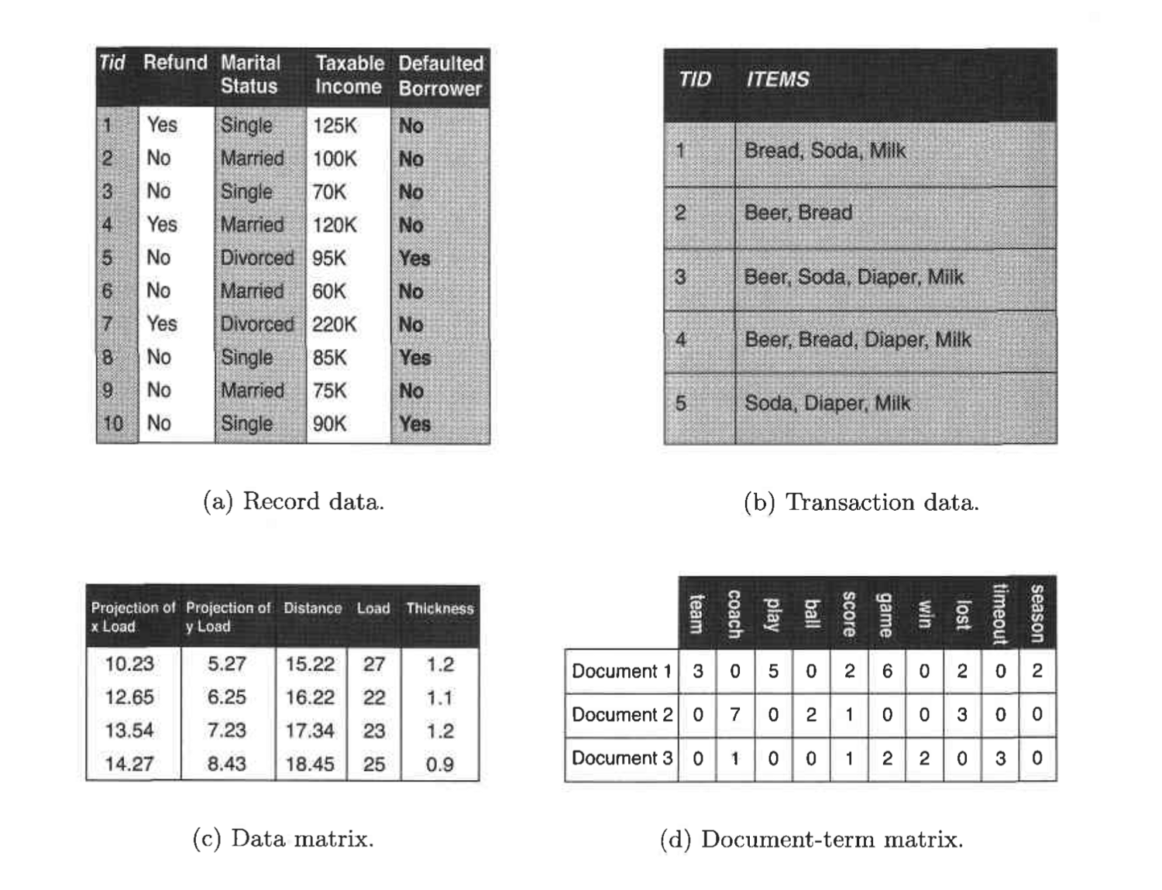

Slide 25
Record Data
Transaction data- Record data→Market basket data
Market basket data because the items in each record are the product in persons market basket.

Slide 26
Transaction or Market Basket Data
It is a special type of record data, in which each record contains a set of items. For example, shopping in a supermarket or a grocery store. For any particular customer, a record will contain a set of items purchased by the customer in that respective visit to the supermarket or the grocery store. This type of data is called Market Basket Data. Transaction data is a collection of sets of items, but it can be viewed as a set of records whose fields are asymmetric attributes. Most often, the attributes are binary, indicating whether or not an item was purchased or not.

Slide 27
Data Matrix (pattern matrix)
If data objects have the same fixed set of numeric attributes, then the data objects can be thought of as points in a multi-dimensional space, where each dimension represents a distinct attribute
Such a data set can be represented by an m by n matrix, where there are m rows, one for each object, and n columns, one for each attribute

Slide 28
Document Data
Each document becomes a ‘term’ vector
Each term is a component (attribute) of the vector
The value of each component is the number of times the corresponding term occurs in the document.

Slide 29
Transaction Data
A special type of data, where
Each transaction involves a set of items.
For example, consider a grocery store. The set of products purchased by a customer during one shopping trip constitute a transaction, while the individual products that were purchased are the items.
Can represent transaction data as record data

Slide 30
Graph Data : Molecular(Data with Objects)
Examples: Generic graph, a molecule, and webpages : Graph Mining : Analyze Graph Data
Benzene Molecule: C6H6

Slide 31
WWW dataset:
Text and link other page
Search Queries on WWW: we collect web pages and process web pages and extract data.

Slide 32
Summary
Revise the Attributes and types
Discrete and Continuous attributes
Asymmetric data attributes
Guidelines or comments on attributes of data
Characteristics of data

Slide 33
Summarized
Revise Characteristics of data and watch imp. Curse of Dimensionality
Data Set meaning
Exploring Statistical types of datasets: univariate ,multivariate…
Data Mining Datasets:
1. Record Data :Flat File(RDBMS), Transaction Data(Market Basket Transaction Data),Data Matrix(Pattern Matrix), Document Data (e.g. Marksheet of students),sparse Matrix
2. Graph Dataset: WWW dataset : Data and link
Molecular Dataset: Relationship among object(Web
Mining)

Slide 34
Thank you!!!

